Slide 1
My Data-Driven Story about Fertility Rates_Pavan Gudimalla
File created on: 4/2/2025 1:51:18 PM

Slide 2
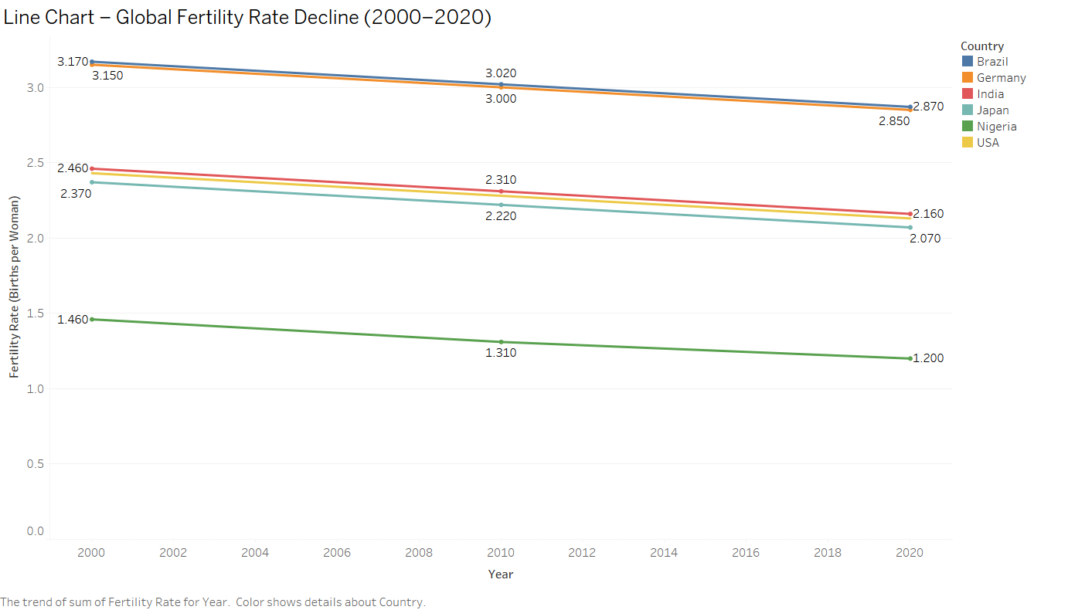

Slide 3
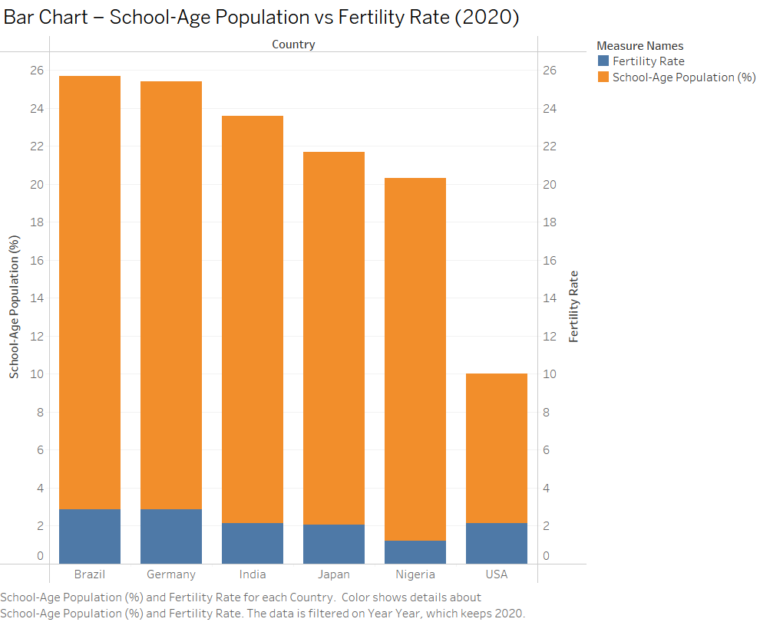

Slide 4
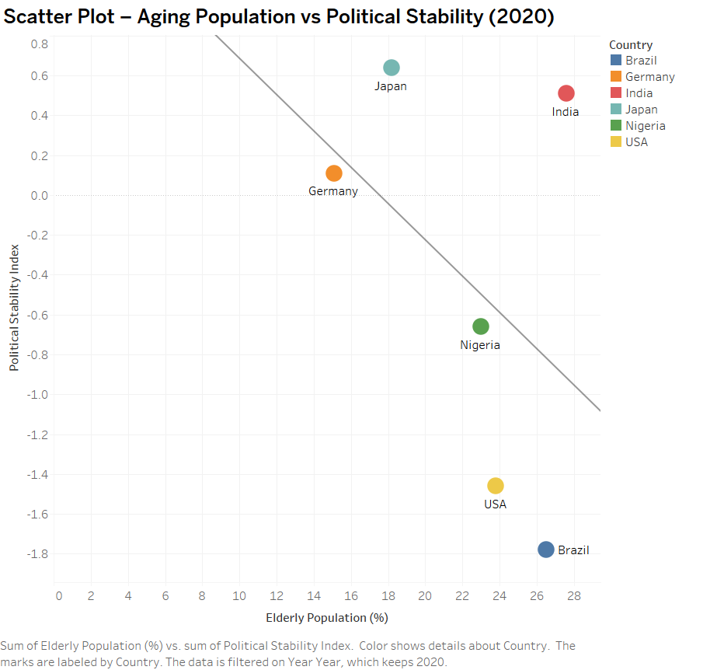

Slide 5
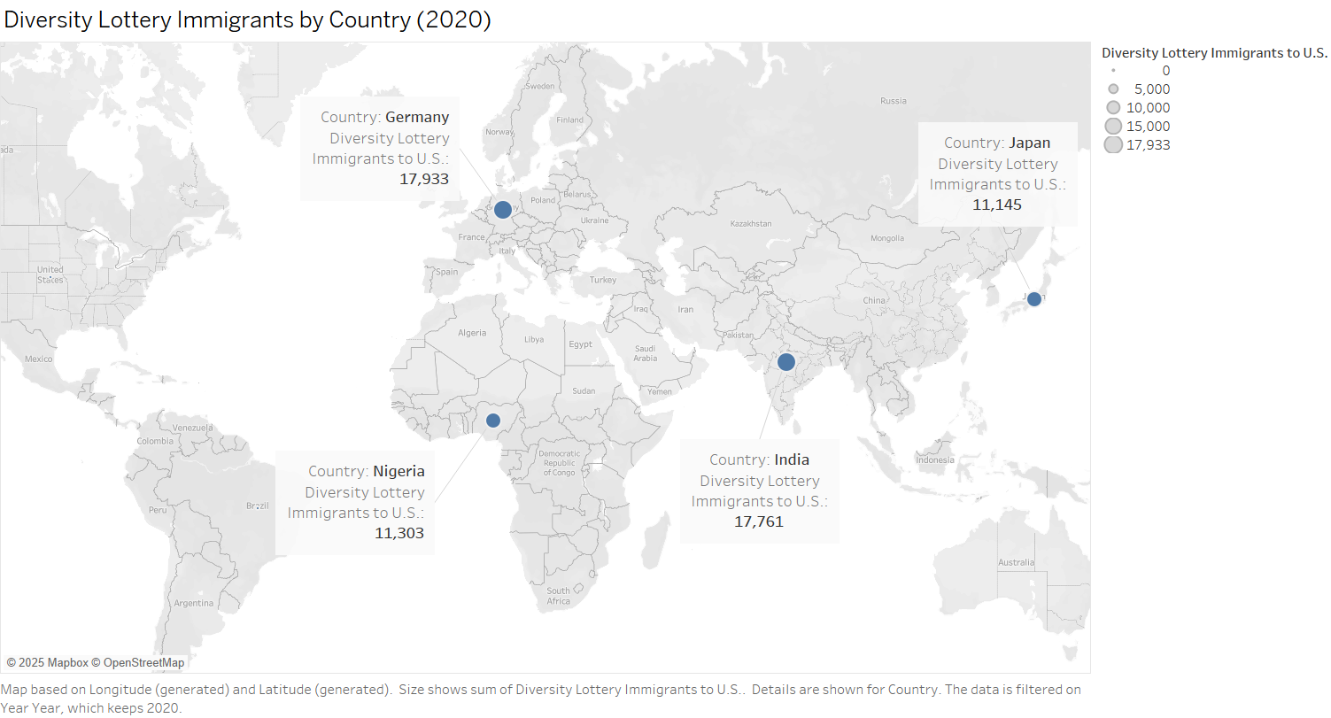

Slide 6
